Slide 1
History of .NET Ecosystem
Lex Li

Slide 2
Lex Li
Software Engineer at Morgan Stanley
Microsoft MVP 2012-2017
https://blog.lextudio.com
Twitter: @lextm

Slide 3

The Book: Legends of .NET (in Chinese) http://dotnet.sxl.cn

Slide 4
Why .NET?
Visual Basic and Visual C++
Java
Visual J++
.NET and C#
Microsoft needs .NET

Slide 5
What is .NET?
It is .NET Framework, right?
Common Language Runtime
C#/VB.NET
Base Class Libraries
Other libraries
CLR/C#/BCL are ECMA standards

Slide 6
Microsoft Flavors
.NET Framework
.NET Compact Framework
.NET Macro Framework
Silverlight

Slide 7
.NET Framework

Slide 8
Timeline (.NET)
2002
.NET 1.0
2005
.NET 2.0
2010
.NET 4.0
2000
.NET beta

Slide 9
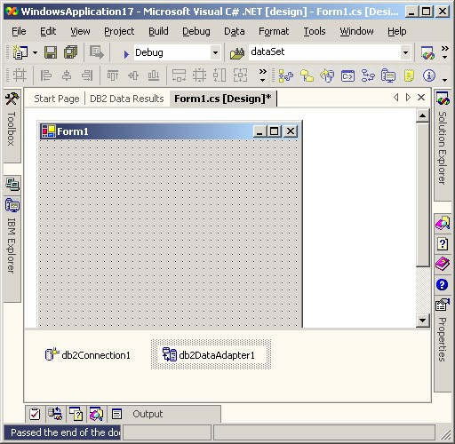
Feb 13, 2002 .NET Framework 1.0 Visual Studio .NET 2002

Slide 10
Rapid Application Development
Windows Forms for desktop apps
ASP.NET WebForms for web apps
Multiple languages: C#，Visual Basic .NET，Managed C++, J# and more

Slide 11
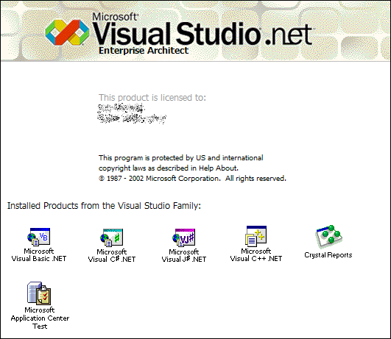
Apr 03, 2003 .NET Framework 1.1 Visual Studio .NET 2003

Slide 12
Significant Changes
ODBC and Oracle support
ASP.NET WebForms mobile browser support
Visual Studio 2003 with Compact Framework
IP v6 support

Slide 13
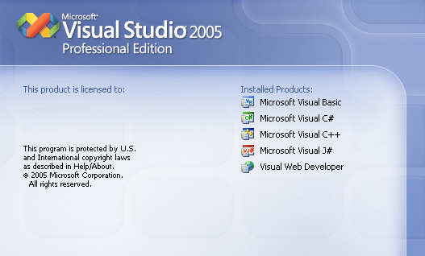
Nov 07, 2005 .NET Framework 2.0 Visual Studio 2005

Slide 14
Significant Changes
64 bit support
C# with true generics
SQL Server 2005 integration and ADO.NET improvements
ASP.NET WebForms Improvements
Visual Studio 2005 with Macro Framework
MSBuild, MSTest

Slide 15
Nov 06, 2006 .NET Framework 3.0 Nov 19, 2007 .NET Framework 3.5 Visual Studio 2008

Slide 16
Significant Changes
WPF
WCF
WF
Entity Framework
C# with LINQ

Slide 17
Apr 12, 2010 .NET Framework 4.0 Visual Studio 2010 Aug 15, 2012 .NET Framework 4.5 Visual Studio 2012

Slide 18
Significant Changes
Task Parallel Library
Parallel LINQ
Dynamic Language Runtime
C# with async/await

Slide 19

Anders Hejlsberg
Turbo Pascal
Borland Pascal
Delphi
Visual J++
C#
TypeScript

Slide 20
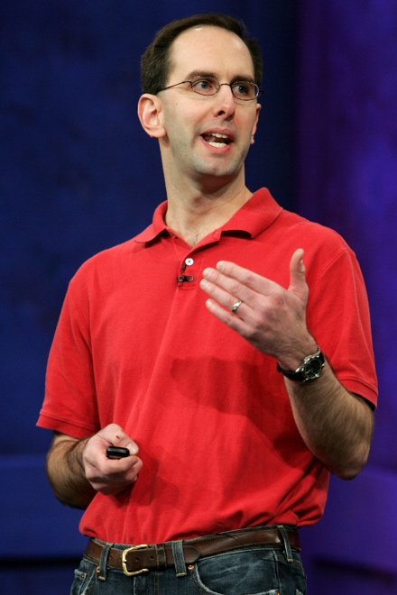
Scott Guthrie
Lead Program Manager
Product Unit Manager
General Manager
Corporate Vice President
Executive Vice President

Slide 21
Community Contribution
Jun 2000 JUnit -> NUnit
Sep 2000 SharpDevelop
Jan 2001 .NET Reflector
Jun 2001 Mono
Jul 2001 Ant -> NAnt
Sep 2001 JavaDoc -> NDoc

Slide 22
The Mono Project and Xamarin

Slide 23
What is Mono?
.NET Framework for Linux and Mac?
Competitor of Java?

Slide 24
Why Mono?
Linux desktop application development trap
CLR/C#/BCL are ECMA standards
Native-managed interoperability

Slide 25
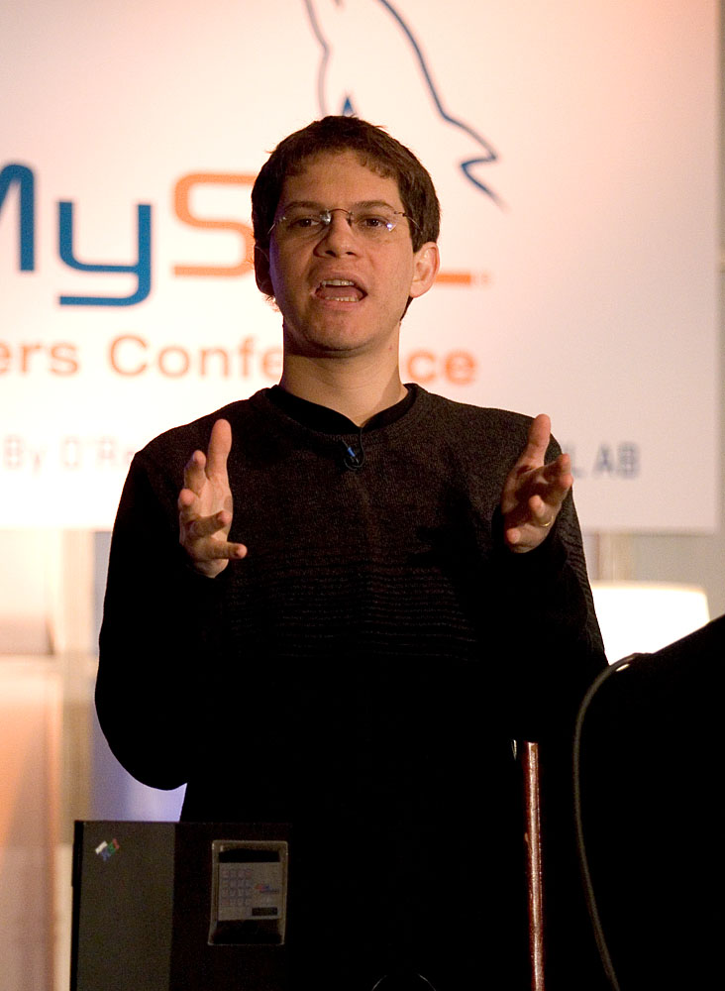
Miguel de Icaza
Leader of GNOME
Ximian CTO
Novell Vice President
Xamarin CTO

Slide 26
Nat Friedman
GNOME President
Ximian CEO
Novell CTO
Xamarin CEO

Slide 27
Timeline (Mono)
2001
Mono Beta
2004
Mono 1.0
2008
Mono 2.0
2012
Mono 3.0
2015
Mono 4.0

Slide 28
Mono
Jun 2001, project launched at Oreilly Conference
Jun 2002, 1.0 was feature complete
Apr 2003, AOT started to be investigated
Aug 2003, Novell acquired Ximian
Feb 2004, MonoDevelop IDE launched
Jun 2004, Mono 1.0 officially released
GTK# + WebForms

Slide 29
Nov 02, 2006 Mono 1.2 Oct 01, 2008 Mono 2.0 Jan 09, 2009 Mono 2.2

Slide 30
Significant Changes
Windows Forms on Mono
Official AOT
Mono with Unity3D
SIMD support

Slide 31
What is next?

Slide 32
2007 iPhone! Mobile computing era started!

Slide 33
iPhone
Jan 09, 2007 Steve Jobs revealed iPhone
Jun 29, 2007 iPhone shipped
Oct 17, 2007 Steve Jobs announced iPhone SDK
Mar 06, 2008 iPhone SDK released
Jun 09, 2008 iPhone 3G revealed
Jul 11, 2008 iPhone 3G shipped with App Store online

Slide 34
Unity on iOS?

Slide 35
Ahead of Time Compilation
C# to native
No JIT
ARM BINARY
.NET
AOT
.APP
C#
Runs natively
Bindings

Slide 36
Unity on iOS
Feb 26, 2008
Unity/Mono started to work together
Mar 06, 2008
Apple released iPhone SDK
Mar 31, 2008
Unity announced iOS plan
Oct 03, 2008
Unity iPhone shipped

Slide 37
What is next?

Slide 38
Mobile Apps for iOS Development in 2008
Objective C (no Swift yet)
CocoaTouch
Xcode
Memory leak (no ARC yet)
Notes:
Automatic reference counting 直到2011年才随iOS 5引入

Slide 39
C# for iOS?

Slide 40
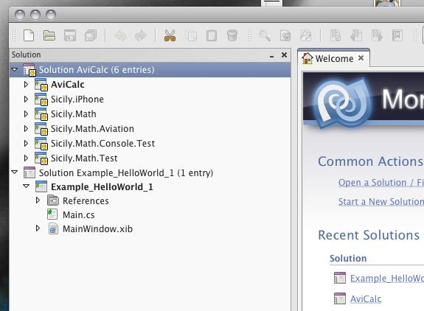
Sep 14, 2009 MonoTouch 1.0 Nov 04, 2009 MonoTouch 1.2

Slide 41
MonoTouch
C#
.NET Framework BCL
XIB CodeBehind and iOS native API
MonoDevelop with Interface Builder
GC
Soft debugger for simulator and devices

Slide 42
Same Day Support
Apr 03, 2010 iPad shipped with iOS 3.2
Apr 07, 2010 MonoTouch 2 shipped for iPad
Jun 23, 2010 MonoTouch 3 for iOS 4
Jun 24, 2010 iPhone 4 shipped with iOS 4
Oct 12, 2011 MonoTouch 5 for iOS 5
Oct 14, 2011 iPhone 4S shipped with iOS 5

Slide 43
What is next?

Slide 44
Mar 17, 2011 MonoMac 1.0 Apr 06, 2011 Mono for Android 1.0

Slide 45
What is next?

Slide 46
Attachmate acquired Novell and the April 2010 layoffs

Slide 47
May 16, 2011 Xamarin started CEO Nat CTO Miguel

Slide 48
May 01, 2012 XobotOS

Slide 49
May 14, 2012 Mono for Android 4.2

Slide 50
Feb 20, 2013 Xamarin 2

Slide 51
May 28, 2014 Xamarin 3

Slide 52
Nov 17, 2015 Xamarin 4

Slide 53
Xamarin Sketches

Slide 54
Xamarin Inspector

Slide 55
Xamarin Test Cloud

Slide 56
Xamarin + Microsoft = ?

Slide 57
Feb 24, 2016 Microsoft acquired Xamarin

Slide 58
Microsoft: Closed to Open

Slide 59
The Beginning
Apr 05, 2004 WiX open sourced at SourceForge
Jun 27, 2006 CodePlex launched
Oct 03, 2007 .NET Framework reference code
May 15, 2008 Enterprise Libraries open sourced
Jul 02, 2008 Sandcastle open sourced
Oct 02, 2008 Managed Extension Framework open sourced

Slide 60
Core Products Open Sourced
Apr 02, 2009 ASP.NET MVC 1.0
Apr 16, 2010 Dynamic Language Runtime
Nov 04, 2010 F#
Jan 03, 2011 NuGet
Mar 28, 2012 ASP.NET MVC/Web API/Razor
Jul 19, 2012 Entity Framework
Apr 03, 2014 Roslyn

Slide 61
Nov 12, 2014 .NET Core open sourced with OS X and Linux support

Slide 62
Timeline (.NET Core)
2014
.NET Core Beta
2016
.NET Core 1.0/1.1
2017
.NET Core 2.0/2.1

Slide 63
Jul 20, 2015 .NET Framework 4.6 Apr 05, 2017 .NET Framework 4.7 May 10, 2017 Mono 5.0

Slide 64
Scott Hanselman
Corillian Chief Architect
Microsoft MVP
Microsoft Principal Program Manager

Slide 65
Julia Liuson
Corporate Vice President

Slide 66
The Future

Slide 67
Xamarin.Forms => WPF/GTK#/macOS
Notes:
是不是可以支持 OS X，Linux 和 Windows 的桌面程序开发？一个程序一套界面自适应各种平台

Slide 68
Mono AOT => .NET Native
All platform support?
Better performance and smaller size?
Better debugging experience?
Notes:
都仅仅支持几个平台，速度很慢，调试体验未知

Slide 69
More Languange Support?
C#
F#
Visual Basic .NET
C++/CLI，C++/CX
Java （Xamarin RoboVM/RemObjects Ionide)
Pascal（RemObjects Oxygene）
Swift （RemObjects Silver）

Slide 70
.NET IDE
Visual Studio?
Visual Studio Code?
Visual Studio for Mac/MonoDevelop？
Rider (JetBrains)？

Slide 71
Summary
.NET Framework
Mono and Xamarin
Microsoft: Closed to Open
The Future

Slide 72
Resources
The Site http://corefx.strikingly.com

Slide 73
.NET Libraries from China MVP
NPOI
NPOI.CSS
WebSocket4Net
SuperSocket
ENode
#SNMP
WinHtmlEditor

